Slide 1

Ergonomics Semester 2 Week 2

Slide 2
What had been discussed last week
Review the one-page slide
Check out the datasets
Writing the algorithm to apply the coordinates onto cumulative damage assessment

Slide 3
Timeline
Content | Date | Progress
Learning Basics of Deep Learning | Sep 2022 | Done
Installing Alphapose/Openpose | Sep-Oct 2022 | Done
Learning Ergonomics Basics | Oct-Nov 2022 | Done
Forming a Framework of Time Continuous Cumulative Fatigue
Preparing for Final Exam | Nov-Dec 2022 | Done
Review the Time Continuous Cumulative Fatigue Framework | Dec 2022 | Done
Trying to Extract Coordinates Using Alphapose/Openpose | Dec 2022
Adding on a Cumulative Fatigue Assessment using Alphapose/Openpose with Python | Jan-Mar 2023
Writing a Technical Report for our Research | Mar 2023

Slide 4
One-page Slide
Vision_Based_Ergonomic_Cumulative_Risk_Assessment.pptx

Slide 5
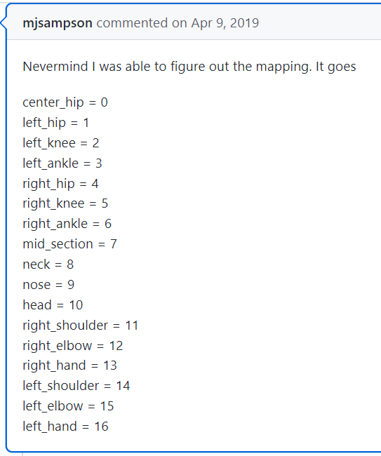
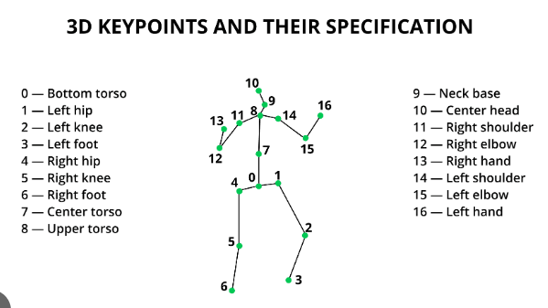
VideoPose3D
1. The corresponding joints of the extracted coordinates are as follows:

Slide 6
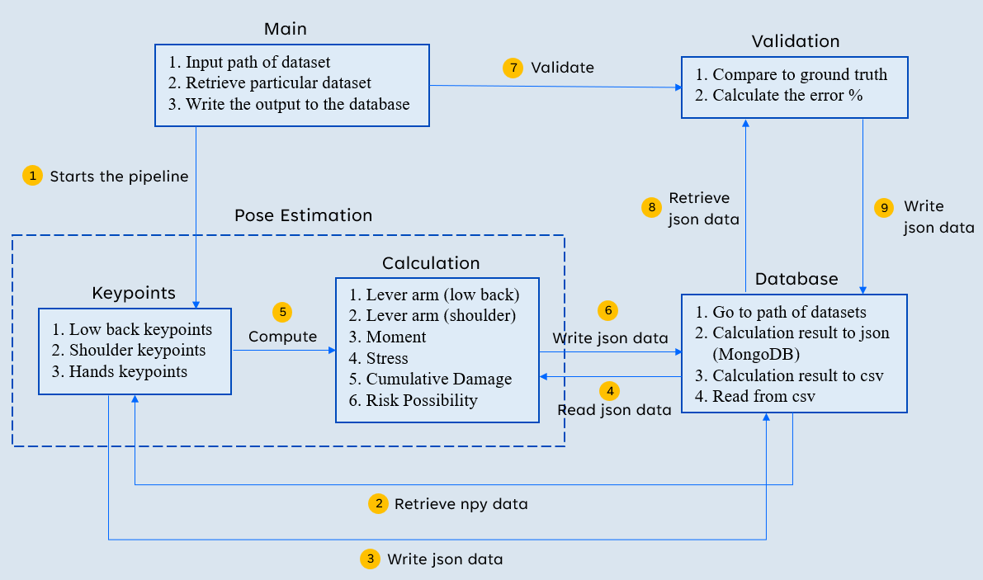
VideoPose3D
Cumulative_Damage_Assessment_Mindmap.pptx

Slide 7
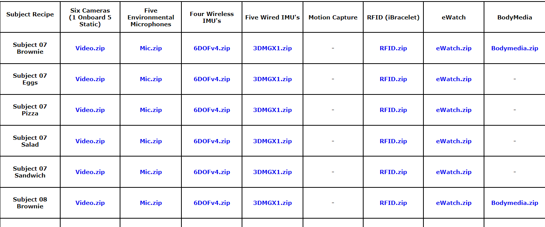
Dataset
CMU Motion of Body Dataset
http://kitchen.cs.cmu.edu/main.php

Slide 8
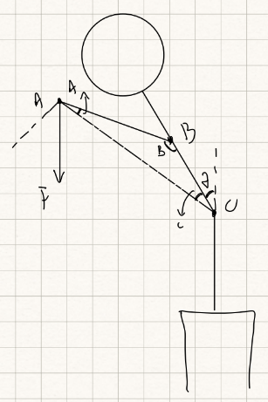
Challenges of This Week
Dealing with the low back flexion angle

Slide 9
Next Meeting
Continue designing the algorithm
Read the paper

